Slide 1
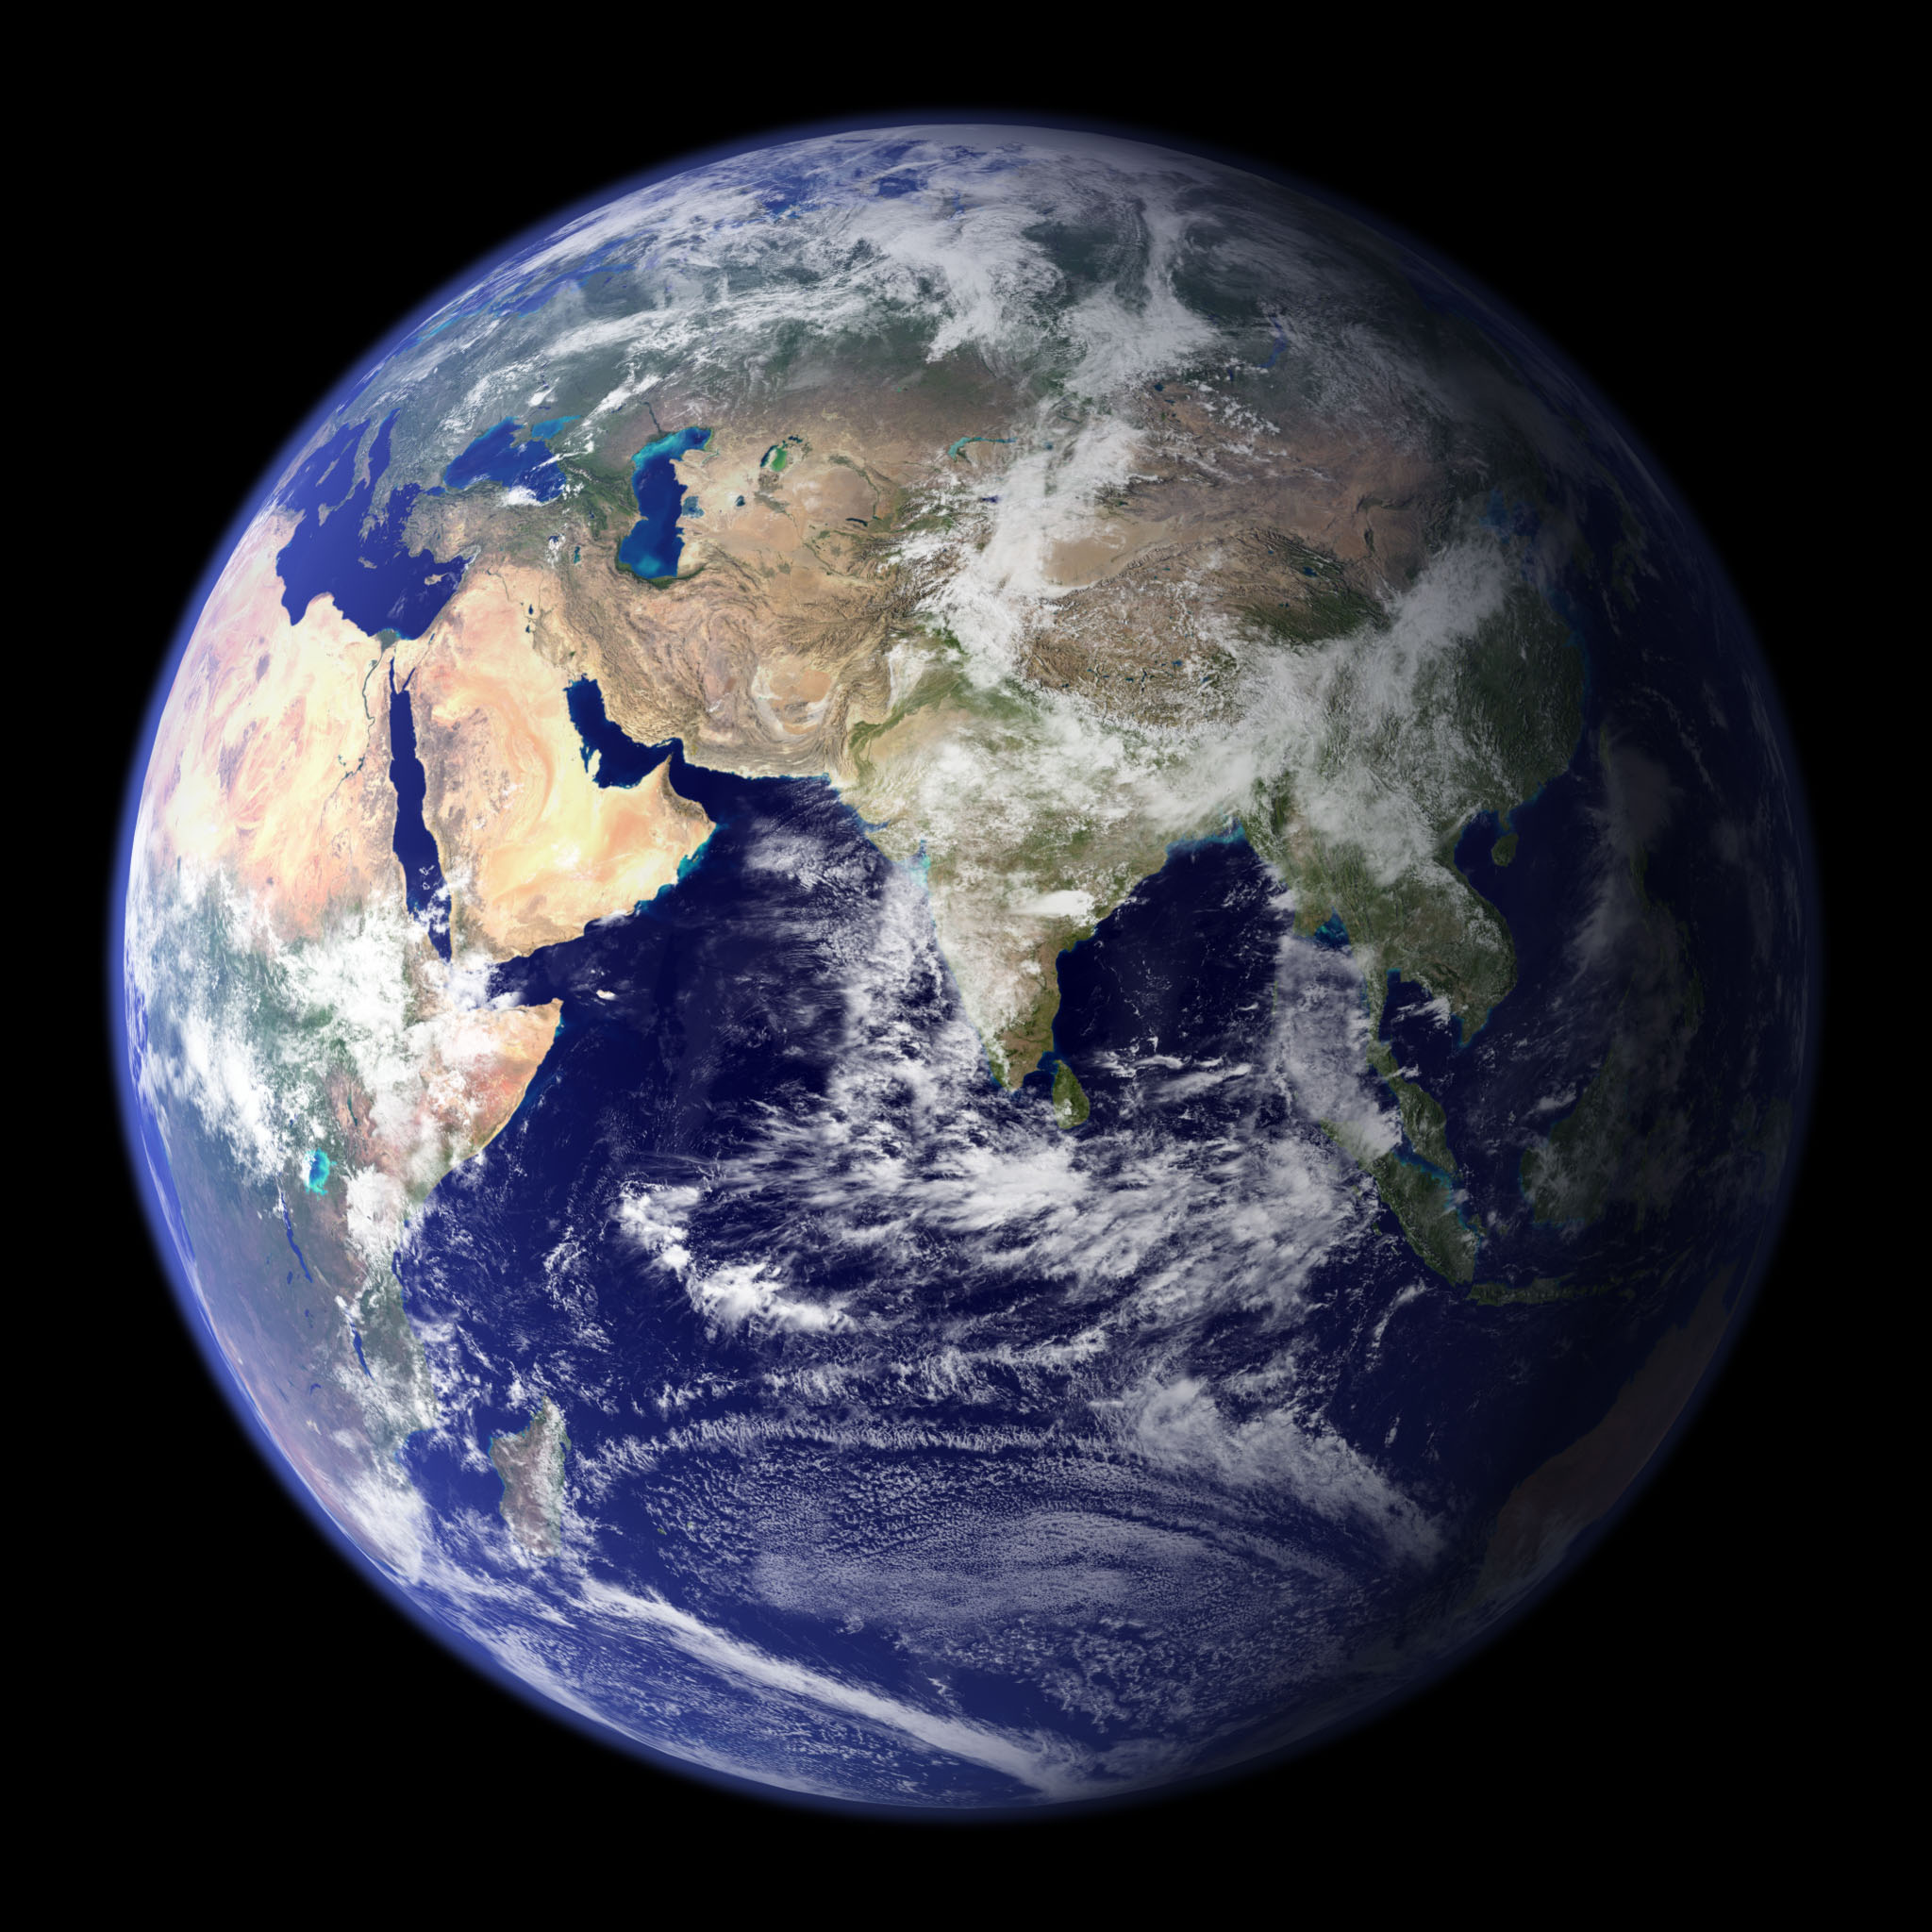

Slide 2
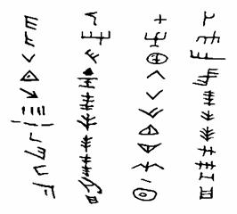
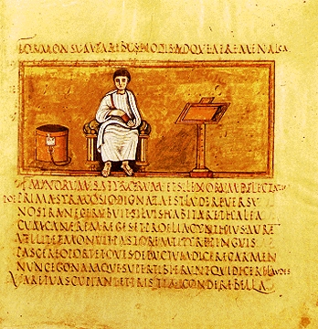
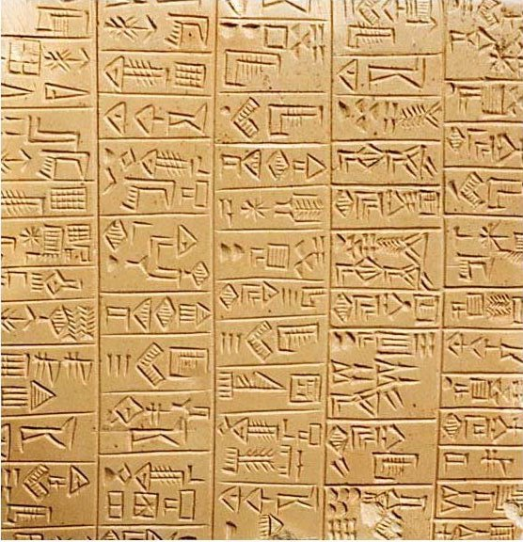

Slide 3
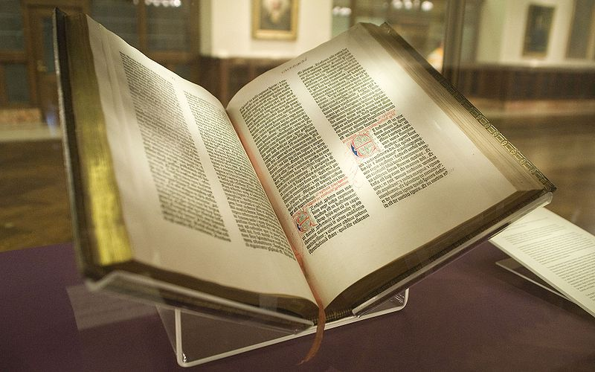

Slide 4
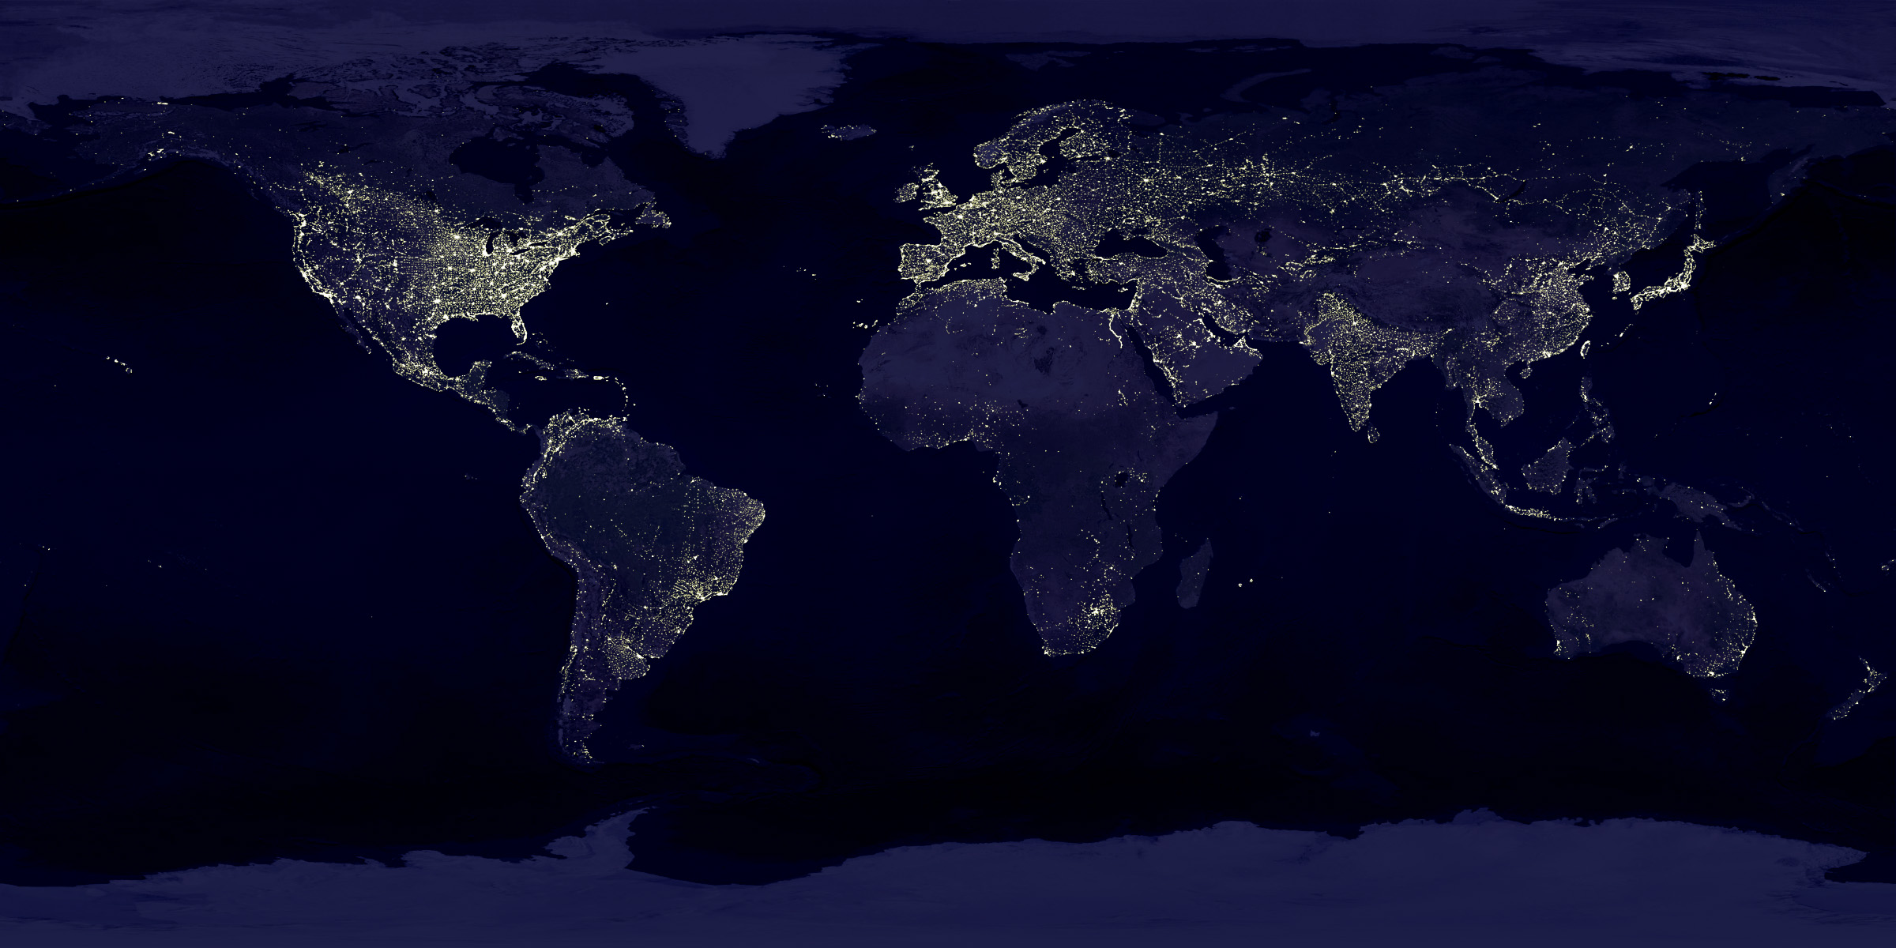

Slide 5
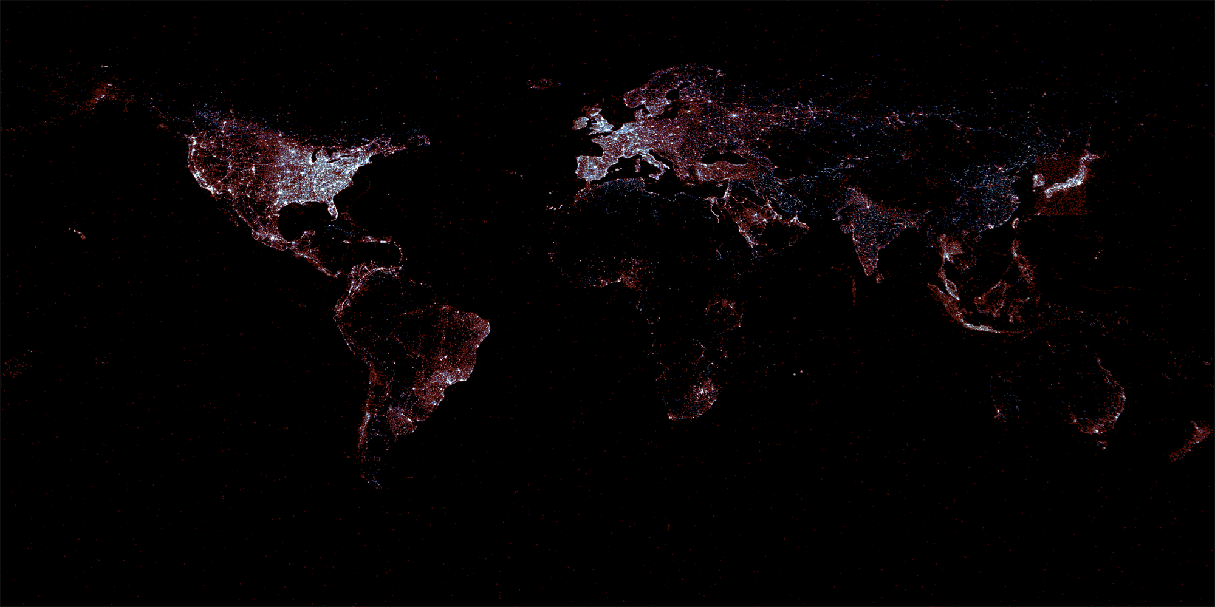

Slide 6
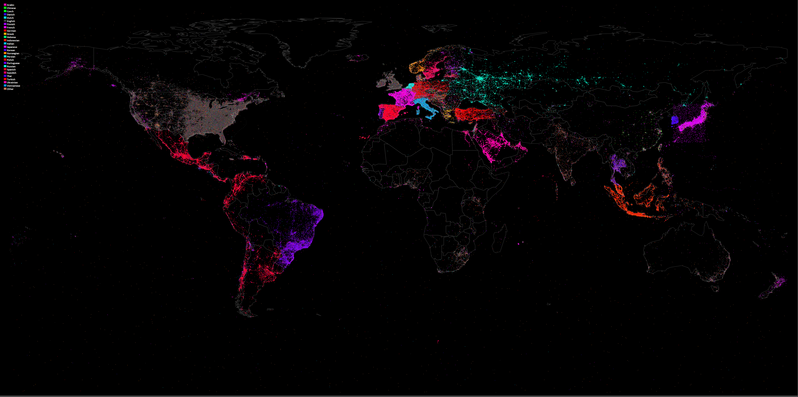
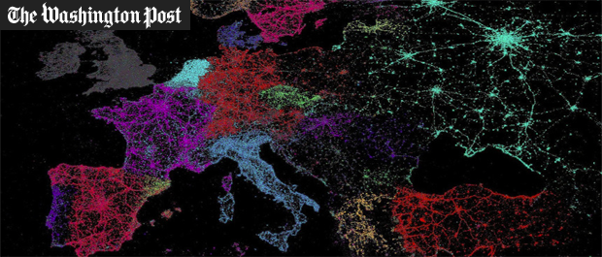

Slide 7
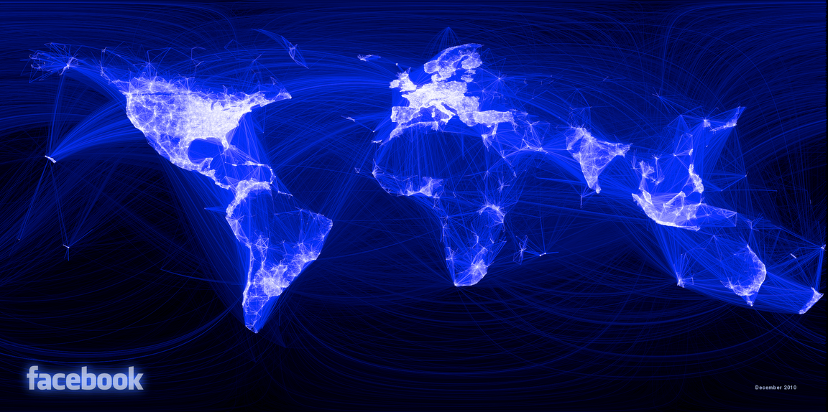

Slide 8
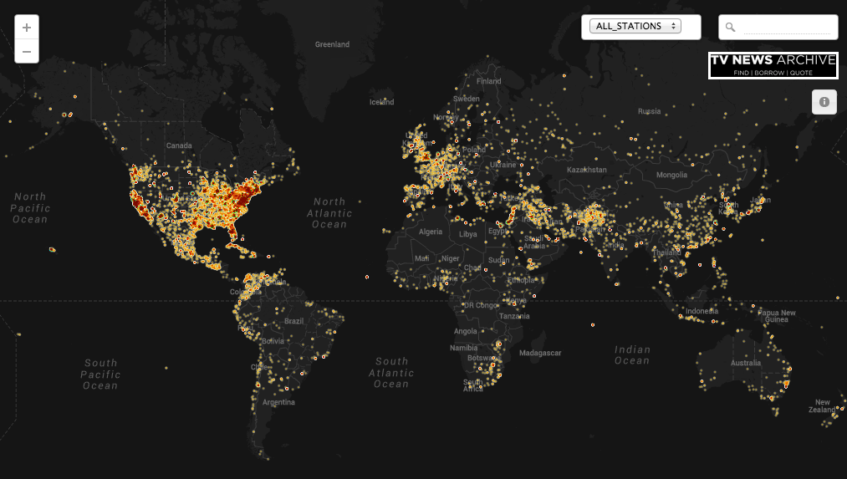

Slide 9
Our Digital World
1/3 global population online
As many cell phones as people on earth
Facebook alone has:
240 billion photographs (35% of all online photos)
1 billion members with 1 trillion connections
Notes:
Fast forward to today and we’ve reached an incredible point in human history.

Slide 10
Every Year
6.1 trillion text messages
2.2 trillion cell minutes in the US alone
107 trillion emails
1.6 million days worth of video uploaded to YouTube

Slide 11
Every Day
2.5 billion new items added to Facebook
300 million photos posted to Facebook
500TB of new data about society’s innermost thoughts posted to Facebook
As many words posted to Twitter every day as the entire New York Times in the last half-century
100 billion+ social media actions taken

Slide 12
Every Minute
600 new websites created
204 million emails sent
700,000 shares on Facebook
200,000 photos posted to Facebook
277,000 tweets sent

Slide 13
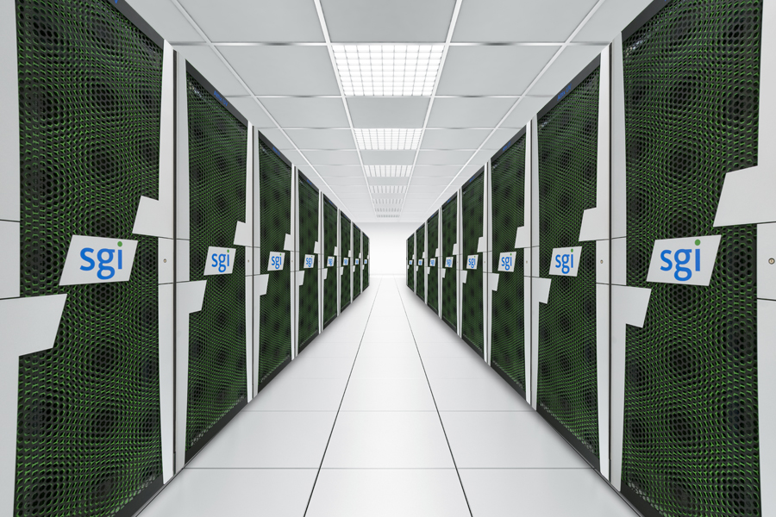

Slide 14
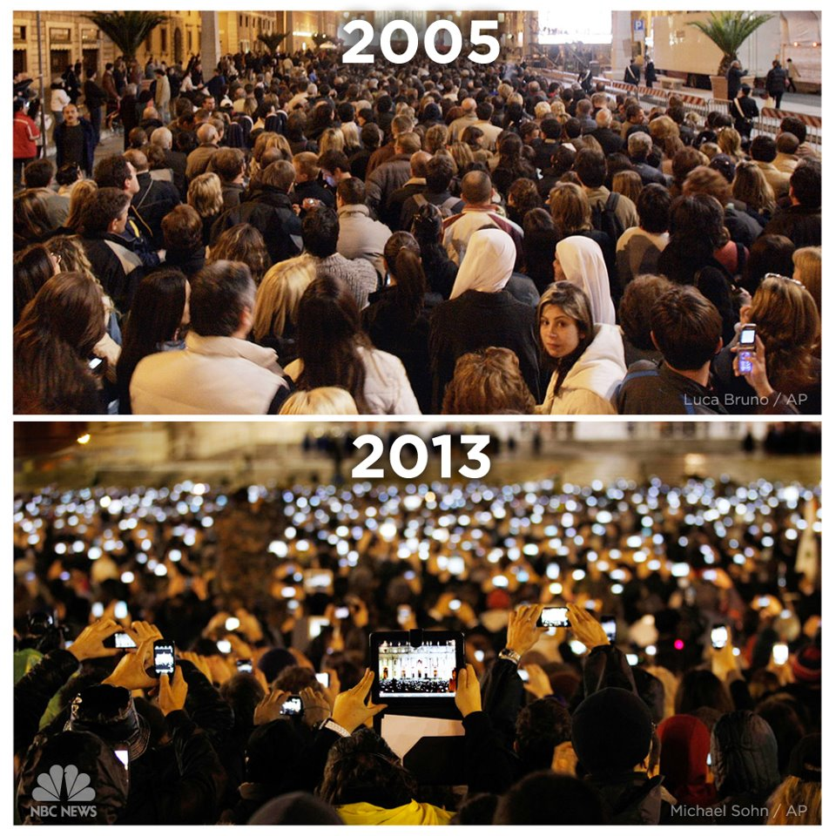

Slide 15
The Rise of Web News

Slide 16
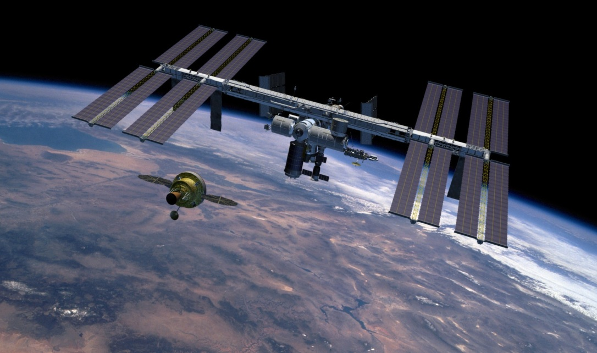

Slide 17
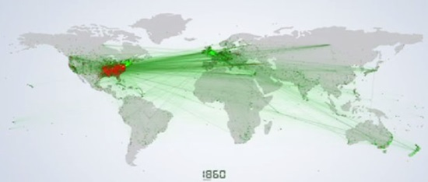
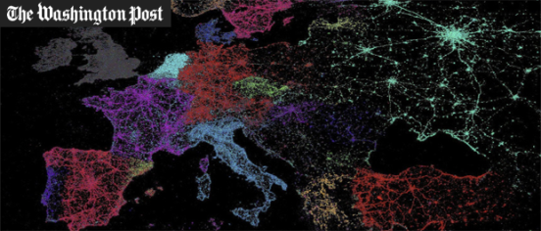
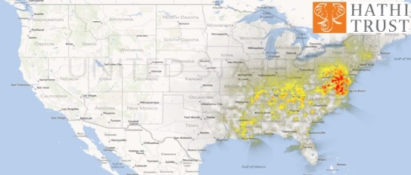
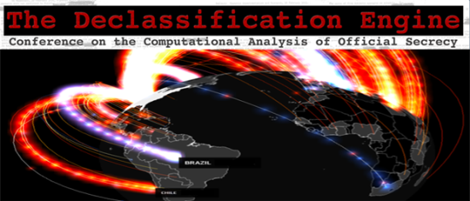
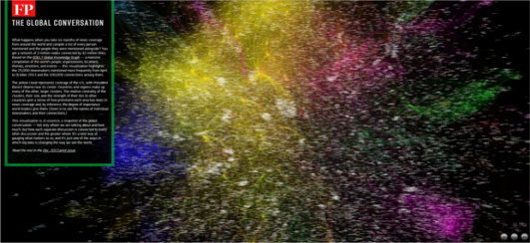
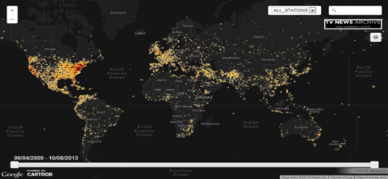
Mapping complete English text of Wikipedia: 80M locations and 40M dates via fulltext geocoding
First large-scale examination of the geography of social media: Global Twitter Heartbeat
Tracing spread of ideas through space over millions of books
Spatial visualization of millions of declassified State Dept cables
Compiling the world’s constitutions in digital form
First large-scale study of how social media is used in conflict
Mapping half a million hours of American television news (2.7 billion words of closed captioning)
First live emotional “leaderboard” for television (NBC/SyFy)
Network diagram of the entire global news media (GDELT/Global Conversation) and 256M global events

Slide 18
Half a Millennium of Imagery

Slide 19
Half a Millennium of Imagery
Think about books as collections of images, not words – instead of OCR’ing books to make them fulltext searchable, what about making them “full image searchable”?
Illustrations, drawings, charts, maps, photographs, and other visual elements…
300 billion words in one digital library, but how many images? No-one knew…
600 million pages in IA’s archive – how many images?
British Library – special extract – can we do for all books?

Slide 20
Half a Millennium of Imagery
Rise of ereaders has brought attention back to images. Image-over-text PDFs are too large for mobile devices, so need web page-like interface with ASCII text and embeddable images.
EPUB format – ZIP file with web pages and images.
Images are preextracted as JPEG files and embedded in text like a web page.
Just have to copy the images out of the ZIP file.
Find their reference in the web page and extract the surrounding text for context. Keyword search 500 years of images!!
Its literally THAT EASY!
No massive new technology, just a new way of thinking about content.
EPUB format is an industry standard, meaning this could be done on most digital libraries
~60M images from ~1 million books

Slide 21
Half a Millennium of Imagery
Simple PERL script that unpacks ZIP file into RAM, extracts the images from the stream, finds their refs in the HTML, and saves the images and context snippets to disk – trivial right?
~50 lines of code total, takes just a few seconds to run
Scale up to 1 million books containing 60 million images
IO is primary bottleneck
Just 1-2 weeks to run the entire project, single VM with 4 cores and shared high-utilization SAN available and shared environment, can’t setup exotic storage systems

Slide 22
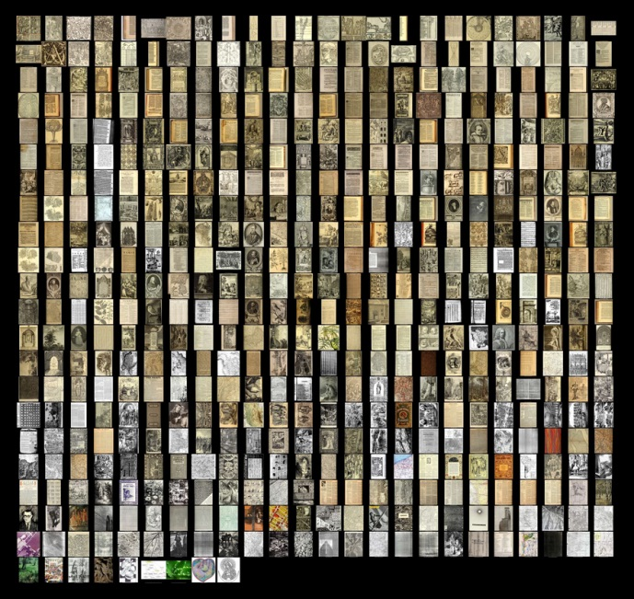

Slide 23
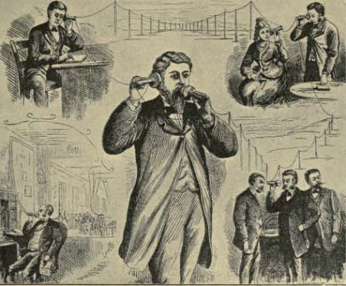
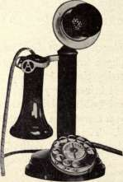
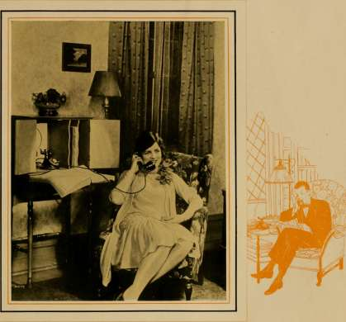
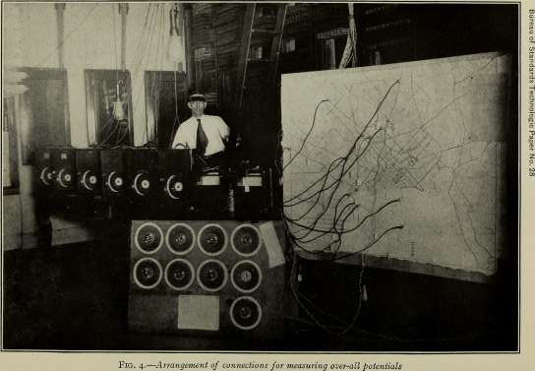
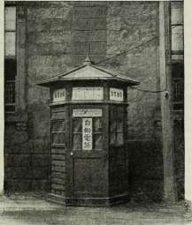
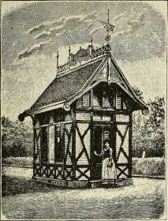
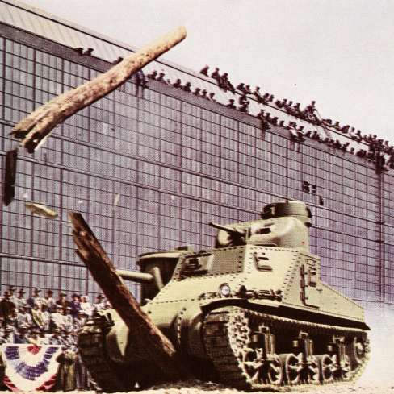
The Telephone

Slide 24
Technical readout
Single PERL script running via GNU “parallel” – data movement primary obstacle
ZIP files stream-extracted into memory and processed in RAM – saves touching slow disk
End goal was to provide series of TAR files, by year, of all 60 million images – means saving by year – biggest issue just managing 60M small files
Prototype just saved them all to disk – 60 million images in a filesystem is awful – 24+ hours to tar a directory over network filesystem
Cloud is nice because you can just wipe the FS when done
ReiserFS – packed 1.1 billion files into a filesystem and it held, but recovery tools poor
XFS – 600 million files – delete is very slow, but creation and access is fast using parallel allocators, vast improvement over original IRIX implementation
HDF5 – parallel allocation for variable-sized files problematic
Higher resolution version will likely use WARC file packing and repack to TAR

Slide 25
Technical readout
High-parallelism HPC filesystems designed for small numbers of very large files
For another project, a major academic supercomputing center had to allocate separate physical storage array and hook to their cluster after we crashed their primary HPC filesystem repeatedly
Facebook, Google, etc, have elaborate technical architectures to store high-velocity blob objects like this, but not easy to replicate that architecture for rapid-turnaround unique data projects that will only last for a few weeks and when you have a small number of machines
This is often the greatest challenge – no standing infrastructure, or each project needs different infrastructure

Slide 26
HALF A MILLION HOURS OF TELEVISION

Slide 27
Internet Archive Television News Archive
Largest television news archive on earth
609,992 shows recorded / 488,118 shows with closed captioning streams
1,417 programs from 63 channels
2.7 billion words of closed captioning (~110 words per minute)

Slide 28
GEOCODING TELEVISION NEWS
Apply “fulltext geocoding” to half a million hours of news – recognize and disambiguate mentions of location worldwide
Need fast language detection and captioning error assessment – captioning will devolve to gibberish at random for large blocks of time
Closed captioning worse material to deal with – far worse than OCR
Worse-case constructions: “he loved Paris after visiting the store in Madrid, he always bought the Paris two brown or two black at a time” or “he //////// Paris >>>>>>” which was actually “he bought pairs of pants”.
Story segments sometimes 10-20 seconds long in rapid succession – 30 minute broadcast might discuss events in 50-100 cities and interweave and cross-reference them – disambiguation nightmare.

Slide 29
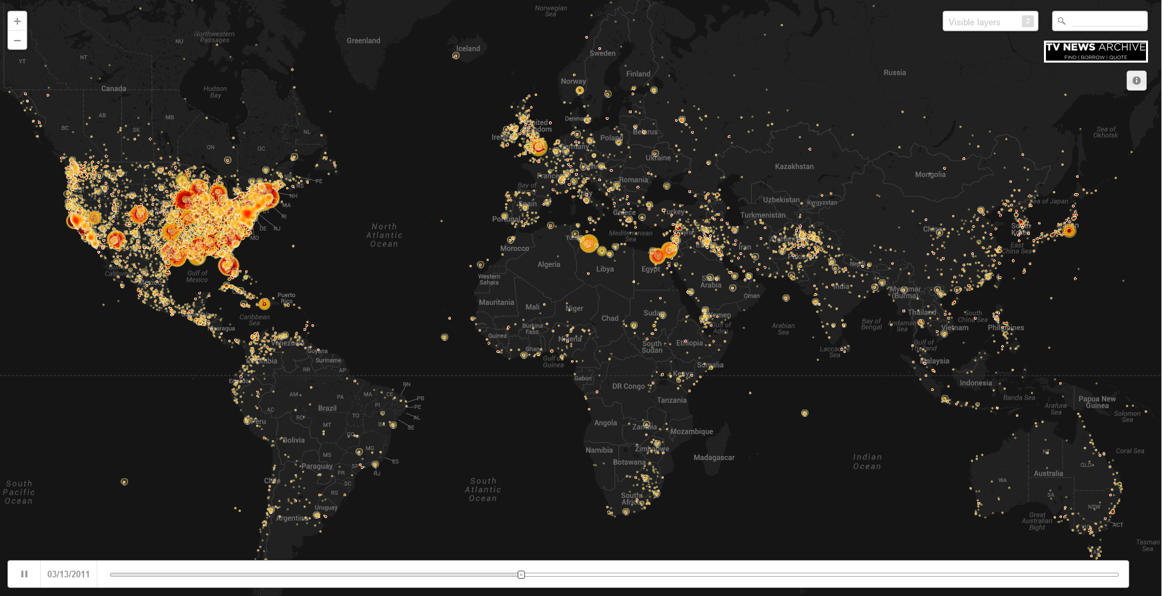

Slide 30
Technical readout
Most geocoders use part of speech tagging to identify noun phrases – fails on foreign names in many areas of the world, simple grammar errors can cause POS tagging to fail miserably. OCR error, machine translation, non-native speakers, informal speech, closed captioning all present unique challenges. Single comma in the wrong place can throw Stanford NLP tool into chaos.
Geocoder used here works in reverse – removes all words that aren’t location-related, then uses step-back process using word probability tables – robust to grammatical error and placenames with English verbs
Largest error source was the “Paris” example, where similar-sounding words were converted to actual placenames in ambiguous contexts that could be location mentions – required building probability table over likelihood of mention of every place on earth

Slide 31
Technical readout
Substantial iteration
Largest landmark-level geocoding effort across this many stations, meant heavy manual iteration to refine algorithms
Some stations even multilingual in single broadcast - iteration to fine-tune ability to catch language and error rate
Primary issue here – just a few days to complete entire project from scratch – suddenly have massive archive of content and have to turn around an interactive map – common thread of the big data world – fast turnaround and each project totally different – hard to create standing pipelines
How to enable scholarly access to material while protecting content held in trust? - the Virtual Reading Room

Slide 32
GEOGRAPHY OF TWITTER

Slide 33
GEOGRAPHY OF TWITTER
Huge literature using geotagged tweets – but do they match reality?
How do we move from 3% geotagged tweets to 30%, then to 75%?
Compare with NASA night lights to create gold standard, then use as gold for testing range of geocoding algorithms and communicative locality measures
Create global emotional heatmaps in realtime – 3 separate KDE’s plus interpolation, combined to single heatmap with high resolution mesh – 250 cores in parallel

Slide 35
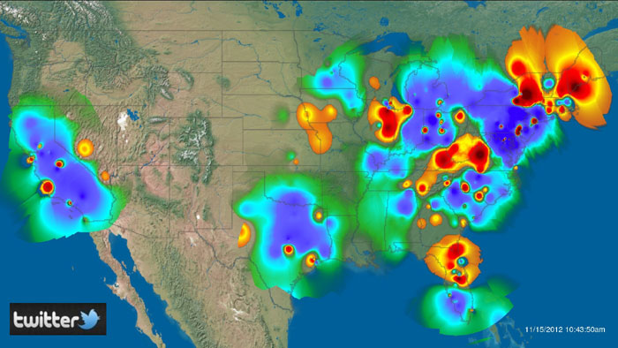

Slide 36
Technical readout
Ignore the documentation and search all the data.
iPhones and Blackberries store their geotagged data in user textual Location field, NOT the geo JSON fields – 33% of geotagged tweets were being ignored by most studies
Always check your assumptions – large number of papers made assumption that people retweet those near them most often, based on communication patterns from other platforms, so assigned location as centroid – but on Twitter there is a 50/50 split of local/international communication
In the past most computation was batch-based – in the future more data is stream-based, never-ending, so no chance to catch up – algorithms have to be adaptable to work faster with less accuracy as needed to keep up

Slide 37
SYFY CHANNEL’S #oppworlds THE FUTURE OF TELEVISION

Slide 38
Syfy #oppworlds
Create the world’s first fully interactive television experience where the audience commentary on Twitter actually drives the show in realtime over the entire course of the show – move beyond “tweet to save John” to the actual emotional response
How do you represent emotion on television that is captivating and integrate it into the show experience? Even the colors and layout matter
How do you measure emotion?

Slide 39
Syfy #oppworlds
Emotion mining (“tone mining” / “sentiment mining”) is one of the hottest fields. Also one of the worst – majority of tools so error-prone to be dangerous. Driven by CS community, not users
Extensively tested commercial and research systems – error rate abysmal
Required reexploring how emotion is expressed online – in English hashtags very common – complex word expansion “#ilovetheshowoppworldssomuch” – can’t just build a dictionary, have to dynamically expand

Slide 40
Syfy #oppworlds
Most commercial systems incorporate some degree of automated dictionary construction or expansion – pile of ☺ and ☹ tweets as training data – 70% accuracy, but for the wrong reasons
“dumb” is positive and “so” is extremely negative – “you so dumb” is correct, but “you dumb” or “you are dumb” are coded positive
“dumb” massively more negative than “agony” or “horrific”
“Emily” is very negative, same for “Limbaugh”, “Obama” much more negative now than he was – great findings, but not what you want in your dictionary driving your findings
“Monday” is a horribly negative word – not good for Monday-night football
Vast majority of time in innovative big data projects is in the human piece of tuning the algorithms and understanding the data – iterating with the machine

Slide 42
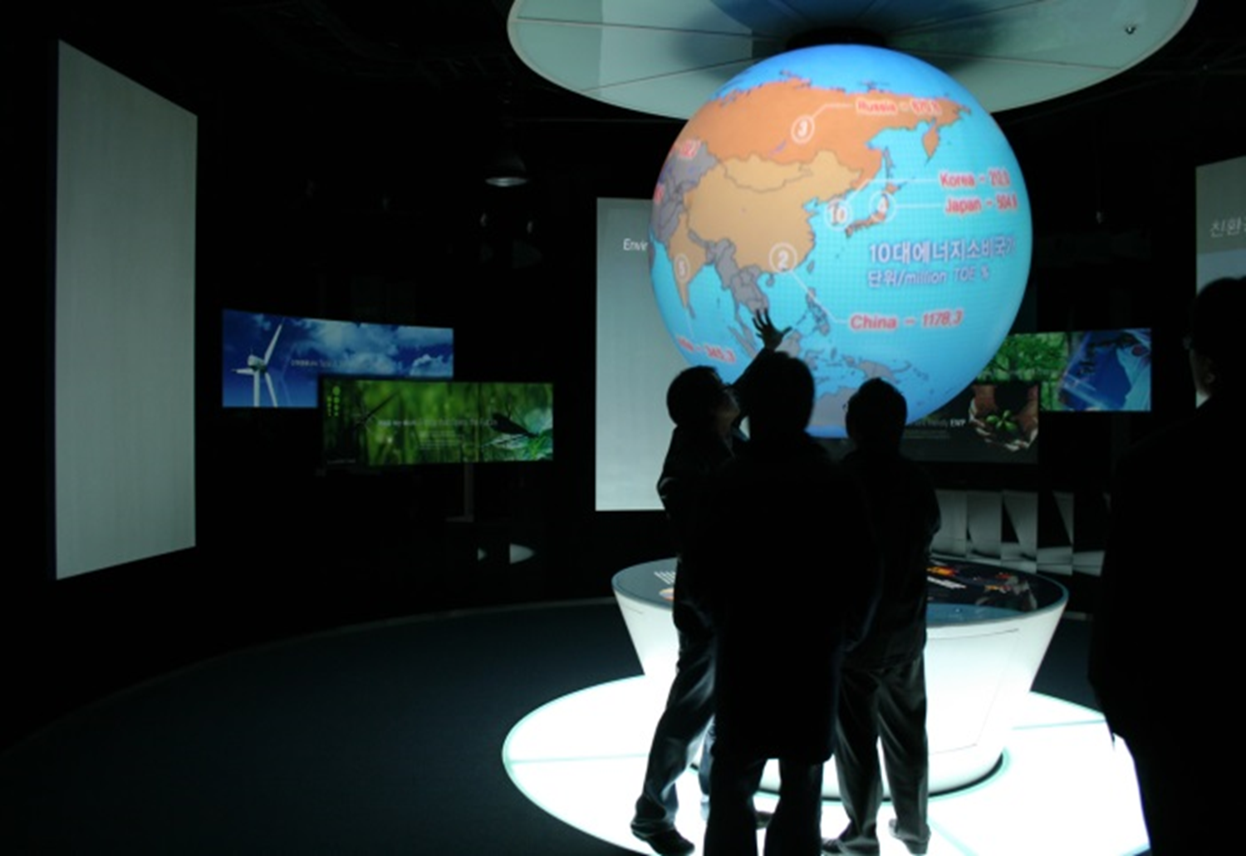

Slide 43
A Global Societal-Scale Real-time Dashboard
Notes:
Could we create the ultimate dashboard – a room full of displays that tell us everything happening in the world, as it happens, who is involved, and how the world is reacting to it, all in realtime?

Slide 44
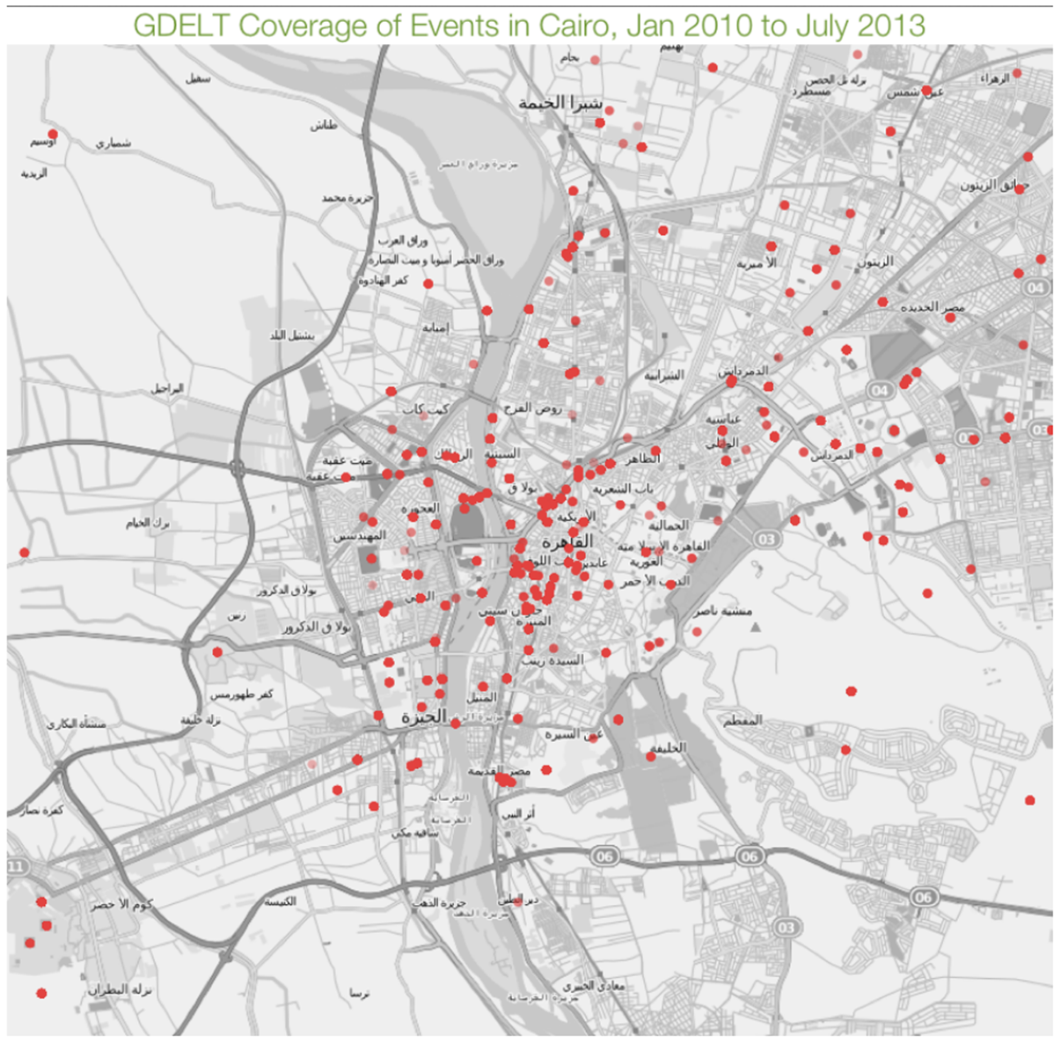
What is GDELT?
The Global Database of Events, Language, and Tone (GDELT) is an initiative to construct a catalog of human societal-scale behavior and beliefs across all countries of the world, connecting every person, organization, location, count, theme, news source, and event across the planet into a single massive network that captures what's happening around the world, what its context is and who's involved, and how the world is feeling about it, every single day
A global georeferenced catalog of a quarter-billion “events” worldwide in 300 categories 1979-present, updated daily
Open academic equivalent to DARPA’s Integrated Crisis Early Warning System (ICEWS), but vastly enriched, leveraging local sources in every country, including human and machine translation
~2 year goal to translate all worldwide news media in realtime in 80 languages
Combined with global network graph over every person, organization, location, theme, event worldwide
Daily updates, moving to 15 minute updates next month
Source: Caerus Analytics
Notes:
Sophisticated algorithms read a news article and translate the blob of text into a spreadsheet listing all of the events mentioned in the article, along with mappable coordinates where the event took place, allowing you to take a pile of news articles about unrest in Egypt and literally put the events they describe onto a map and do this in realtime
Events are coded to the resolution of the news article – here is a map of Cairo showing the Egyptian unrest is coded to buildings and major landmarks, providing a high-resolution view of the conflict.

Slide 45
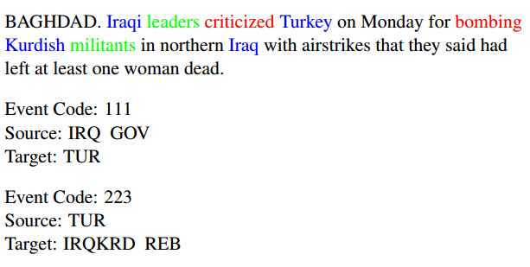
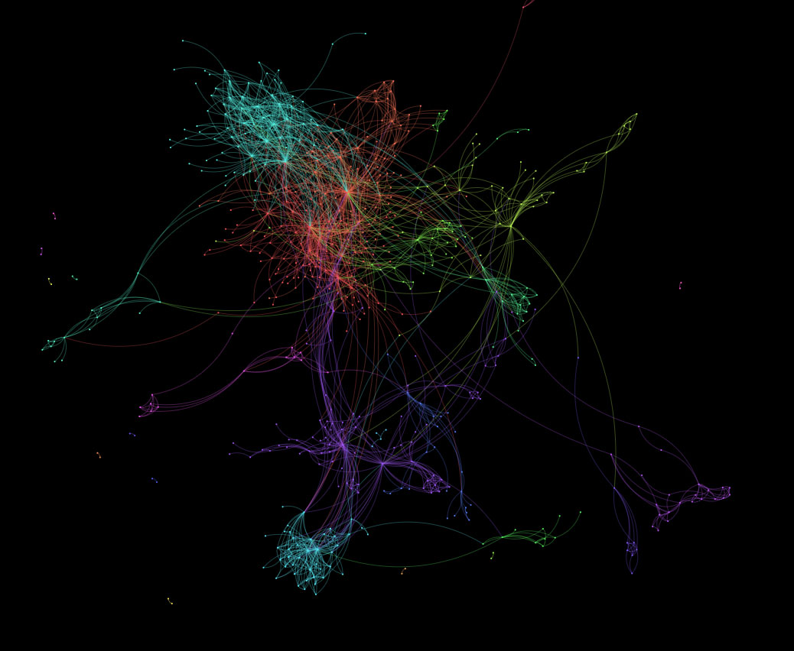
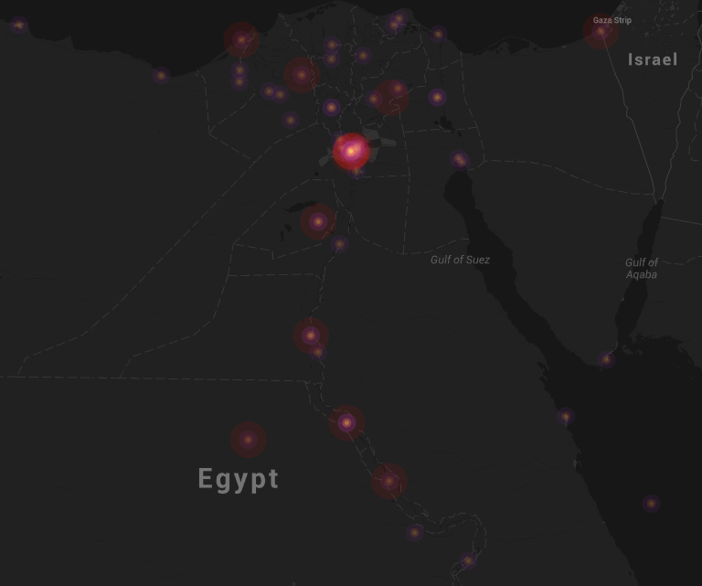
Global Event Database
Global Knowledge Graph
Notes:
Sophisticated algorithms read a news article and translate the blob of text into a spreadsheet listing all of the events mentioned in the article, along with mappable coordinates where the event took place, allowing you to take a pile of news articles about unrest in Egypt and literally put the events they describe onto a map and do this in realtime
Events are coded to the resolution of the news article – here is a map of Cairo showing the Egyptian unrest is coded to buildings and major landmarks, providing a high-resolution view of the conflict.

Slide 46
Data Sources
GDELT relies on tens of thousands of broadcast, print, and online news sources from nearly every corner of the globe in over 100 languages dating back to 1979.
In addition to a vast array of translated domestic broadcast and print material, the historical backfile of GDELT makes extensive use of AfricaNews, Agence France Presse, Associated Press, Associated Press Online, Associated Press Worldstream, BBC Monitoring, Christian Science Monitor, Facts on File, Foreign Broadcast Information Service, The New York Times, United Press International, and The Washington Post.
GDELT also has several pilot projects experimenting with incorporating realtime and hyperlocal social media sources, including understanding the geography of social media and engaging in discussions with citizen crisis mapping organizations.
Will extend back to 1800 by Fall 2014.
Global machine translation of worldwide news media - pilot underway
21 billion words of academic literature, unclassified/declassified reports, and dissertations on Africa and Middle East (JSTOR, DTIC, CIA, CORE, CiteSeerX, Internet Archive) 1945-present, Global Knowledge Graph representation available Summer 2014

Slide 47
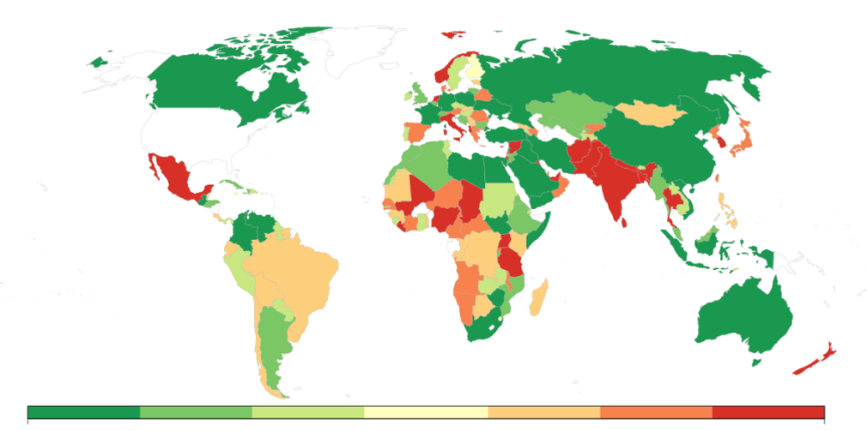
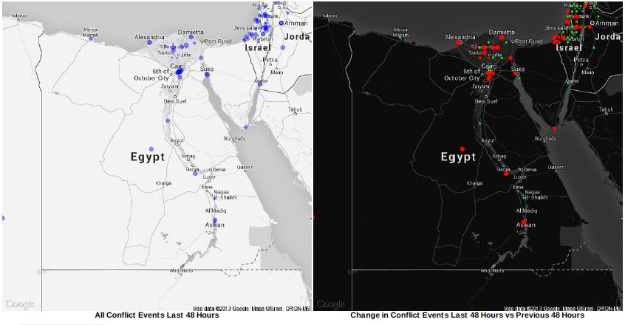
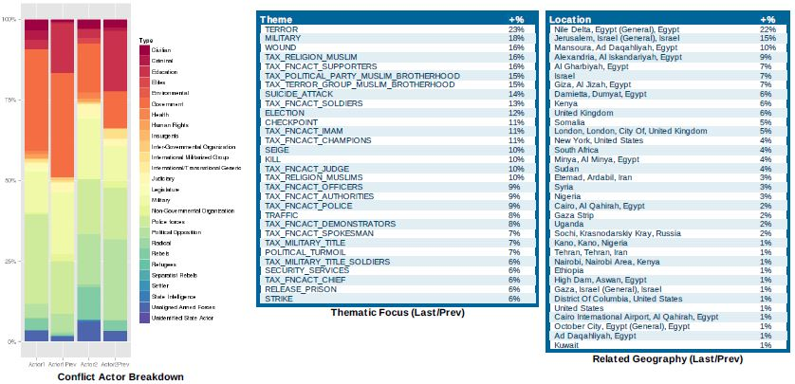
Daily Global Conflict Trend Report
Notes:
Prototype daily trends service that runs each morning and compares Material Conflict in the previous 48 hours around the globe to the preceding 48 hours and compiles a printable visual PDF report summarizing major developments. For the top 10 countries exhibiting the greatest increase towards Material Conflict over the past 48 hours, one-pager Country Detail briefings draw from both the GDELT event data and Global Knowledge Graph to produce maps, charts, and tables summarizing what’s going on, who’s involved, its context, and its significance.
This is a highly experimental prototype, so please use caution when utilizing its findings while we continue to develop it, but we hope this will serve as a useful tool to many and spur new research into how GDELT can be used for global trend detection and dashboarding.
You can access the archive of current reports, dating back to December 15, 2013, on the GDELT website, or subscribe to the Google Groups mailing list we set up for the reports to get the PDF report in your inbox each morning:
https://groups.google.com/forum/#!forum/gdelt-daily-global-trend-report—material-conflict
Python script to customize your own reports!

Slide 48
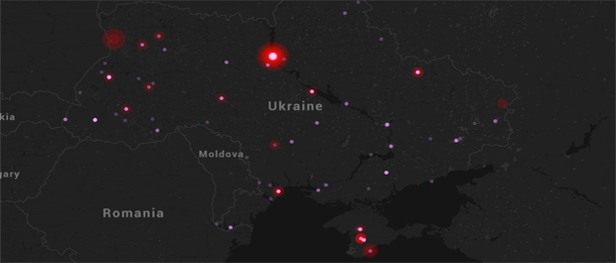
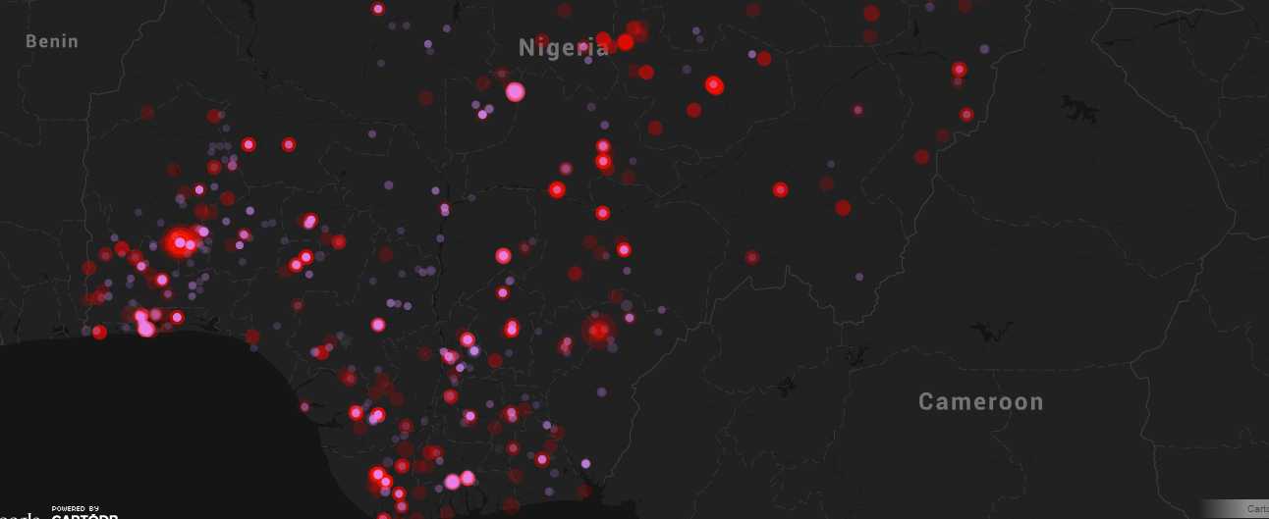
Global Interactive Maps
Nigeria
Ukraine
Notes:
Prototype daily trends service that runs each morning and compares Material Conflict in the previous 48 hours around the globe to the preceding 48 hours and compiles a printable visual PDF report summarizing major developments. For the top 10 countries exhibiting the greatest increase towards Material Conflict over the past 48 hours, one-pager Country Detail briefings draw from both the GDELT event data and Global Knowledge Graph to produce maps, charts, and tables summarizing what’s going on, who’s involved, its context, and its significance.
This is a highly experimental prototype, so please use caution when utilizing its findings while we continue to develop it, but we hope this will serve as a useful tool to many and spur new research into how GDELT can be used for global trend detection and dashboarding.
You can access the archive of current reports, dating back to December 15, 2013, on the GDELT website, or subscribe to the Google Groups mailing list we set up for the reports to get the PDF report in your inbox each morning:
https://groups.google.com/forum/#!forum/gdelt-daily-global-trend-report—material-conflict
Python script to customize your own reports!

Slide 49
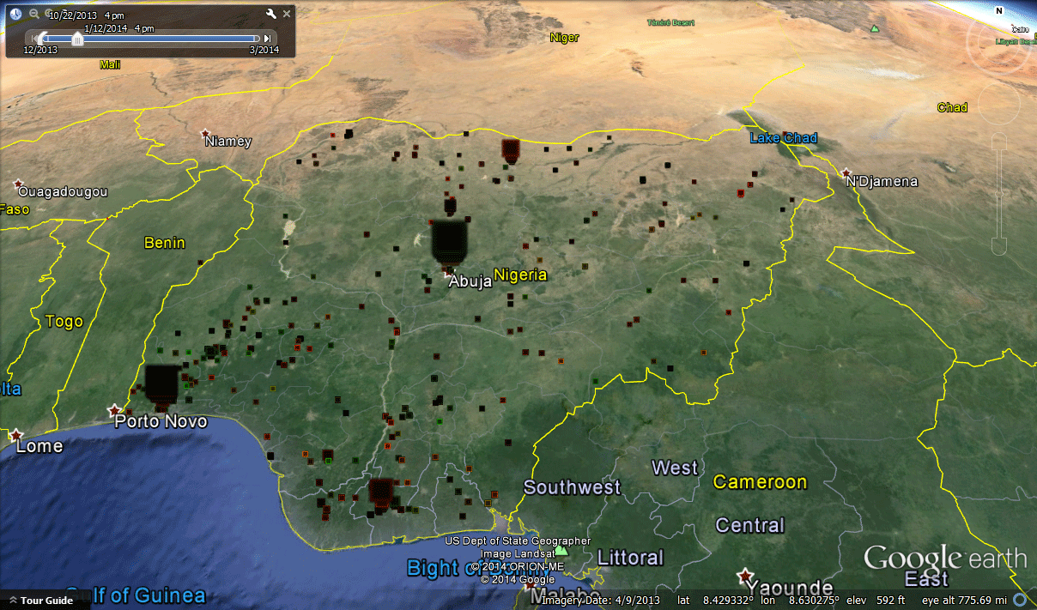
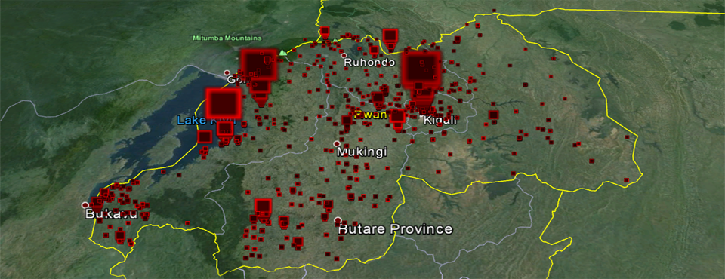
Notes:
Prototype daily trends service that runs each morning and compares Material Conflict in the previous 48 hours around the globe to the preceding 48 hours and compiles a printable visual PDF report summarizing major developments. For the top 10 countries exhibiting the greatest increase towards Material Conflict over the past 48 hours, one-pager Country Detail briefings draw from both the GDELT event data and Global Knowledge Graph to produce maps, charts, and tables summarizing what’s going on, who’s involved, its context, and its significance.
This is a highly experimental prototype, so please use caution when utilizing its findings while we continue to develop it, but we hope this will serve as a useful tool to many and spur new research into how GDELT can be used for global trend detection and dashboarding.
You can access the archive of current reports, dating back to December 15, 2013, on the GDELT website, or subscribe to the Google Groups mailing list we set up for the reports to get the PDF report in your inbox each morning:
https://groups.google.com/forum/#!forum/gdelt-daily-global-trend-report—material-conflict
Python script to customize your own reports!

Slide 50
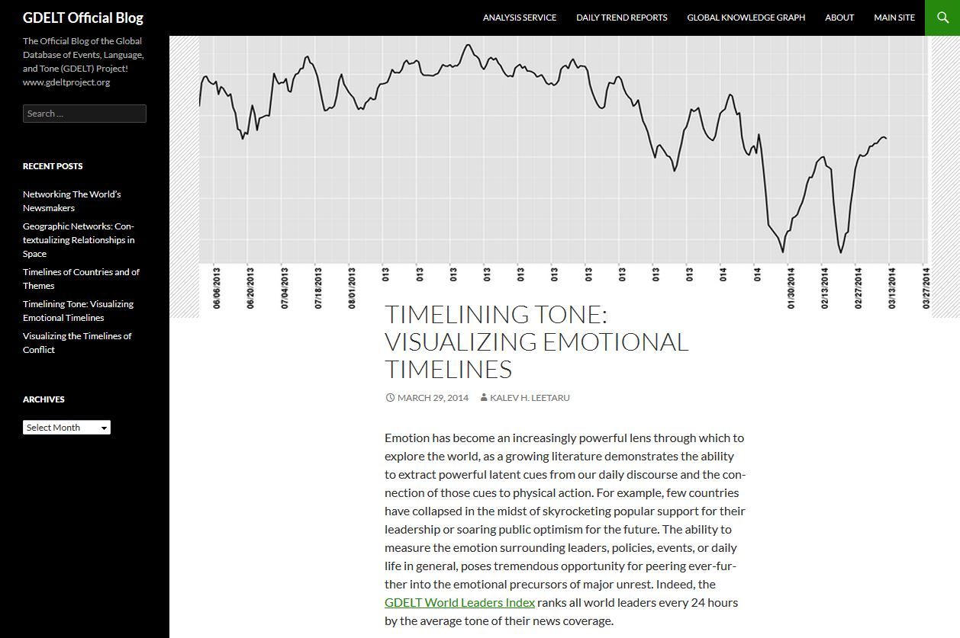

Slide 51
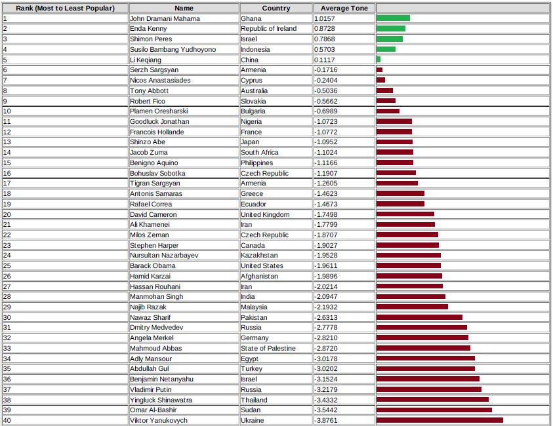
World Leaders Index
Major trends in emotional context of global new media
Notes:
This report reflects major trends in the average emotional context of global news media coverage of the world's heads of state as reported by the GDELT (Global Database of Events, Language, and Tone) (http://gdeltproject.org/) Global Knowledge Graph database. Each day, the average "tone" of all articles mentioning a recognized world leader is computed, from "extremely positive" (a value of +100) to "extremely negative" (a value of -100). In practice, given the massive variation in how world leaders are viewed across the globe, tone usually ranges between +10 and -10. Leaders are only included in a given day's ranking if they received sufficient news coverage during the previous day to yield a measurable tonal score. Tone synthesizes both emotion expressed about a leader and the emotional context of events the leader is currently involved with or being contextualized within. This report is provided as a highly experimental prototype service to demonstrate the use of emotional response and the other latent dimensions of the GDELT Global Knowledge Graph in examining global trends, so please use caution when utilizing its findings.

Slide 52
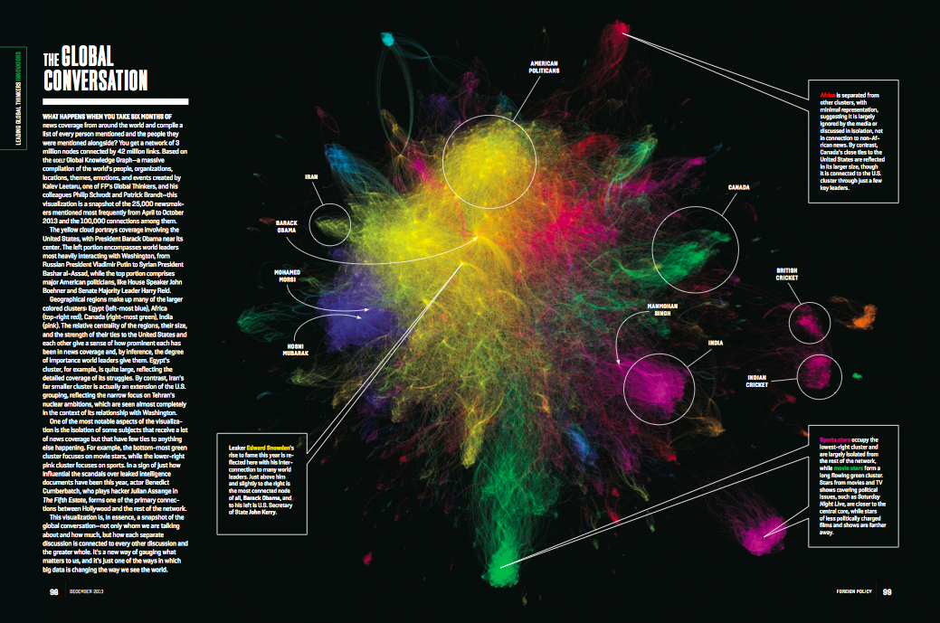
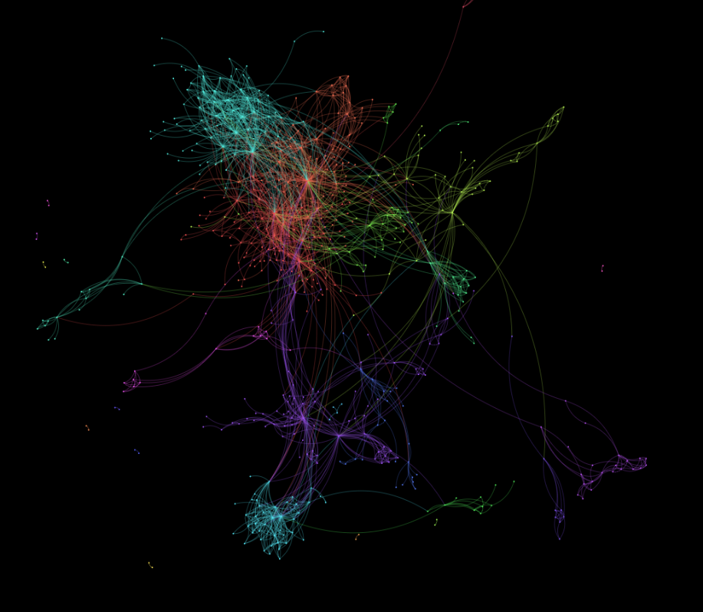
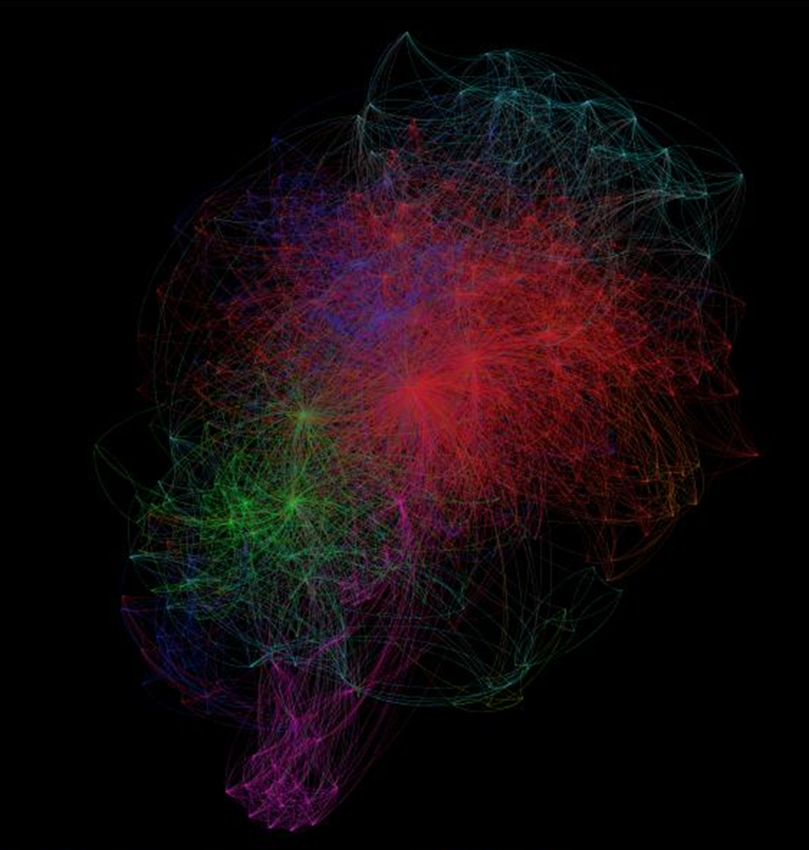
The GDELT Global Knowledge Graph (GKG)
Expands GDELT's ability to quantify global human society beyond cataloging physical occurrences towards actually representing all of the latent dimensions, geography, and network structure of the global news. The GKG attempts to connect every person, organization, location, count, theme, news source, and event across the planet into a single massive network that captures what's happening around the world, what its context is and who's involved, and how the world is feeling about it, every single day.
Notes:
The GKG can be used to understand political and industry influencers, emotion, geography of ideas and discourse
This diagram is over every person mentioned in the global news media in 2013.
Here is an example of building a network diagram over the Nigerian Oil & Gas industry.
Here is a diagram of every person mentioned in global coverage of Snowden and Wikileaks in 2013. We can see the key communities of people. A core finding here is that Snowden is displacing Wikileaks and becoming the key center point of global discussion of government leaking.
All codebooks, category lists, sample scripts for customization are available from the website.

Slide 53
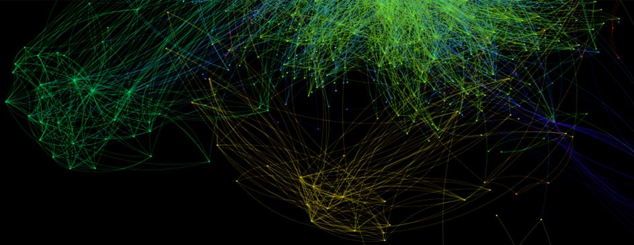
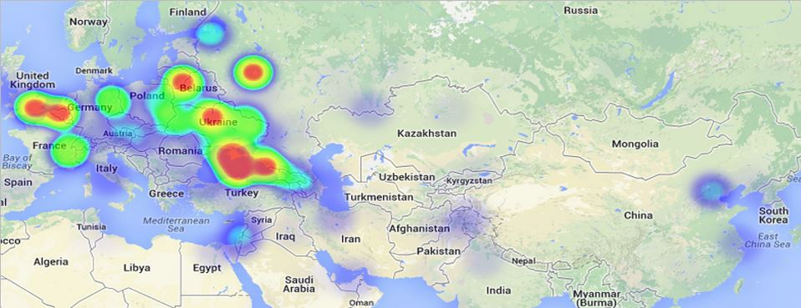
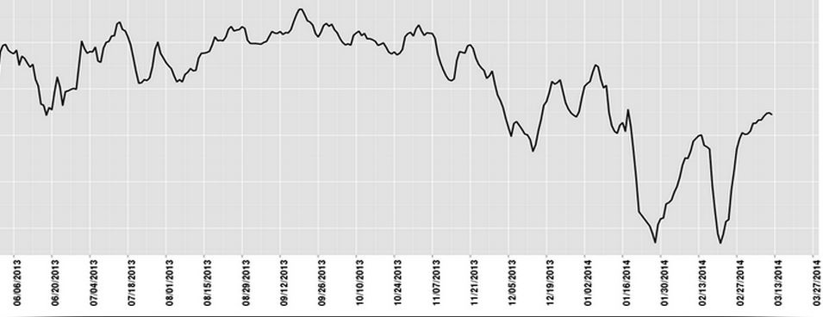
GDELT Analysis Service
EVENT Exporter
EVENT Geographic Network
EVENT Heatmapper
EVENT Timeline
EVENT TimeMapper
GKG Network
GKG Heatmap
GKG Country Timeline
GKG Exporter
GKG Geographic Network
GKG Word Cloud
GKG Tone Timeline
GKG Timeline
GKG Thematic Timeline
Notes:
Cloud-based online analysis service – 14 tools let you point-and-click and get back visualizations and analyses delivered right to your inbox; formats include .csv, .png, .kml, .html, as well as native formats for Gephi, Graphviz, etc.
PERL, Google Big Query, GraphViz, Google Maps, .js, R, sigma.js, Gephi, Gephi Toolkit, R ‘wordcloud’
R Package GDELT Tools
GDELTtools is a package for the R statistical package that makes it easy to download all or some of the GDELT event data, subset it on different variables, and normalize it to make valid time series analysis easier. The latest version 1.2 supports the new GDELT server and adds several new features. The new GetAllOfGDELT function makes it trivial to download and update your local version of the entire data set.
Free visualization tools like Mapbox, Cartodb, Data Driven Documents (D3), etc.

Slide 54
Downloading GDELT
You can use the GDELT Analysis Service or download the entire quarter-billion-record dataset and graph for large-scale analyses.
There are three versions of the GDELT event data available for download.
"Reduced" 1979-2014 Dataset 2.0
Historical 1979 - March 2013 Backfile
Daily Updates April 1, 2013 to Present
There are also a number of helper files to make it easier to work with the data.
CAMEO Lookups and SQL Code for Historical and Daily Updates
In addition to the GDELT event database, the new GDELT Global Knowledge Graph (GKG) is now also available for download.
GDELT Global Knowledge Graph (GKG)

Slide 55
Nigerian Oil and Gas Industry

Slide 56
Mapping US news media tone towards Obamacare by month June 2013 to October 2013
Nigerian Oil and Gas Industry

Slide 57
Vladimir Putin
Nigerian Oil and Gas Industry

Slide 58
Architecture
Housed in Google Cloud.
Ingest and compute colocated on VM’s to enable 15 minute updates – compute as data arrives via deep pipelining.
GDELT Analysis Service – 8 core / 64GB RAM VM.
GKG analyses are brute-forced, kernel buffer cache ensure memory-speed access
Event analyses via Google BigQuery – adhoc querying, complex joins, even regular expressions
Results delivered via Google Cloud Storage
BigQuery – breathtakingly powerful – nearly limitless query complexity still returns in a few seconds over quarter-billion-records and 58 fields
Previously, run your own database on VM’s - lots of tools like Parquet, Hadoop, etc – but huge learning curve and administrative investment to deploy a large instance and manage and admin it over time
Instead, managed service, just plow your data in and it’s a magic black box – fast magic
100,000 inserts per second with realtime availability to queries – stream querying

Slide 59
Toolkit
PERL – core modules are in PERL - string manipulation, pattern matching, regex extraction, etc – fastest language for this
Blend languages across end-to-end pipeline. PERL for text processing, C for numeric (heatmaps), assembler and GPU languages for absolute performance (experimental modeling), Java/JavaScript/AJAX for UI (Analysis Service), R for high-end statistical analysis. Use each language for its strengths.
GDELT: PERL, C, JavaScript, R, Gephi, BigQuery, plus TONS of tools and libraries
Cloud VM’s GREAT for these ecosystems – often end up with two tools that have total conflicts across their libraries and were hardcoded to require certain library paths – just spin up two VMs and solve the issue

Slide 60
Its Not All English
Always remember that most of the world isn’t English
A LOT of tools don’t like Unicode or other non-ASCII data
Often core libraries support Unicode, but hidden third-party translation layers do not – keep an eye on the end-to-end ecosystem of your stack

Slide 61
Data Formats
Internally store in whatever format is easiest to maintain and offers fastest performance – in a real pipeline you have to translate to so many file formats its best to keep in a solid intermediate
Modular is powerful, but be mindful of performance. In enterprise apps, modular has particular utility, in big data exploration, performance dominates
XML is nice, but for massively nested datasets bogs down performance to untenable levels – use for interchange, not internal storage – once saw a web services pipeline of 30 modules all speaking XML to each other – went from 0.00000000001 seconds per process cycle to 1.6 seconds per process cycle
Sometimes have to translate direct between formats – hooking modular is elegant, but try machine translation of English-Russian-Spanish-French-Chinese-Arabic-English – its not pretty
Make use of shell tools like “parallel” and “cut” and others to do rapid transparent transformation in parallel

Slide 62
Bandwidth: Crawling the Web
Many of my projects involve crawling the web – bandwidth-limited
In year 2000, could crawl entire open web at a university supercomputing center – universities today don’t have the bandwidth. In 2005 one CS faculty project was shut down because it consumed the entire bandwidth of a top 10 institution to crawl just a tiny portion of the web
Cloud – pricing model is unique. FREE incoming, PAY for outgoing bandwidth. Since bandwidth-limited, use cluster of f1-micro’s (~ penny/hour), to scan the open web, process what you need, and return only the tiny amount of matching data, etc.

Slide 63
Delivering Data - GCS
Raw daily updates and historical files delivered via Google Cloud Storage - essentially infinite download speed and parallelism – data reflection
Commercial web hosts throttle bandwidth to discourage media sharing – GCS solves this
Delivering results via GCS instead of directly from VM’s disk using web server is CRITICAL – someone shares a result file and it goes viral, generating massive load – with VM would require load balancing, with GCS, its “magic”
Limits exposure plane – can have large cluster of machines without web access deliver files for web download

Slide 64
GCS As Intermediate
>15 years in HPC world, used nearly every HPC data transfer utility made – most require specialized installs, root access, exotic libraries, complex certificate management, non-standard open ports, and behavior that is blocked by firewalls
GCS actually exceeds transfer speed of many of these utilities and works in most environments – “drop in” HPC transfers
Unlike HPC utilities – once uploaded, can download to massive number of machines in parallel, and via HTTP – geographic reflection
99% of my projects have involved remote data centers not sitting on an exotic academic network – transiting commodity internet, and often have to reflect to multiple sites in parallel

Slide 65
The Exploration Process – A Case Study
GOAL: take large fraction of all academic literature on Africa and the Middle East and codify it
HOW?
More than a year of negotiations and discussions.
Need to extract citations and parse them. 100’s of tools out there. Scan recent CS and LIS literature, press releases, discussions, blogs, etc, and ID top 20 tools and try them all. Turns out sometimes tools work great on some content and horrible on yours. Need one robust to historical material and most tools are designed for CS lit, not HASS lit.
ParsCite tool works best on this material. Requires CRF library – took half a day to install on a key machine due to library incompability between customized Linux install and CRF’s needs – installing on cloud VM on Google took just minutes because could tear VM apart without worry – it was spun up just for this task – key advantage of the cloud

Slide 66
The Exploration Process – A Case Study
ParsCite generates proprietary XML format – first glance seems best to just load into an RDBMS
BUT, ParsCite makes large number of errors that require customized scripts to fix - massive scripts with chained regular expressions, huge amount of branching and cascaded rewriting and filtering, and check code – can’t really implement in SQL – if you’re going to have to dump out of RDBMS, might as well do in parallel across cluster on disk
Now, make a histogram of the names. Requires installing several fuzzy genealogy name matching tools – requires reformatting the data to their data input needs, and then writing back translating their output

Slide 67
The Exploration Process – A Case Study
Now, take the cleaned records and fuzzy-matched names and build a network diagram over time
More than 2,200 academic journals, plus open web – citations in so many different formats, hard time to run many traditional linking algorithms, so once again have to write series of scripts, but still limits types of analyses that can be applied, so have to consider dependencies of various methods
Then construct the network – iterative process to adjust cutpoints to generate a well-structured network
Then experiment with Gephi and GraphViz to visualize – how to get small enough for GraphViz?

Slide 68
The Exploration Process – A Case Study
Now, take the cleaned records and fuzzy-matched names and build a network diagram over time
More than 2,200 academic journals, plus open web – citations in so many different formats, hard time to run many traditional linking algorithms, so once again have to write series of scripts, but still limits types of analyses that can be applied, so have to consider dependencies of various methods
Then construct the network – iterative process to adjust cutpoints to generate a well-structured network
Then experiment with Gephi and GraphViz to visualize – how to get small enough for GraphViz?

Slide 69
The Exploration Process – A Case Study
Now, output to GraphViz .DOT format, Gephi .GEXF format, Pajek .NET format, and .CSV format (need four different formats for set of tools)
GraphViz – pushed to close to a billion edges and it generates reasonable results, minimal memory needs – serial code, but FAST
Gephi – struggles past >100K edges
Gephi’s Force Atlas 2 layout engine the best for teasing structure from real-world graphs
Modularity finding – but there are so many implementations that each yield different results!
Many network techniques random – different results each time – need human in the loop to evaluate to find “useful” output
Write more custom scripts to filter data using complex logic, pattern matching, and calculations to tease more complex structure out of network in iterative fashion

Slide 70
The Exploration Process – A Case Study
Now, repeat entire process for mapping.
Now, perform geographic mapping of citations. Now do tonal geographic mapping of thematic citations. Keep mixing and merging data.
So much time is spent moving data around and writing scripts to do recasting or filtering of data.

Slide 71
The Exploration Process – A Case Study
SGI UV2 – 64TB / 4,000 cores in single system image (one machine running one copy of Linux, not a cluster)
RAM disk – buffer cache – 100x faster than FusionIO, 1000x faster than SSD
Rapid interactive exploration, all data and compute stays in one place
Network analysis often can’t be sharded across a cluster – missing edges fundamentally alters structure of network
Reach cost where its faster to compute the network on-the-fly than to store – 2.4PB network – can’t store that on disk, rebuild in a 3D moving window across the network to look for patterns

Slide 72
Thank you!
Kalev H. Leetaru
Yahoo! Fellow in Residence
Georgetown University
Kalev.leetaru5@gmail.com
http://www.kalevleetaru.com
http://gdeltproject.org

